Slide 1

Request Tracker Agent
Copilot Scenario Overview
© 2026 Microsoft Corporation All rights reserved.
Notes:
CELA disclaimer
Terms displayed or discussed are for explanation/education only. Such terms may differ from your agreement.

Slide 2
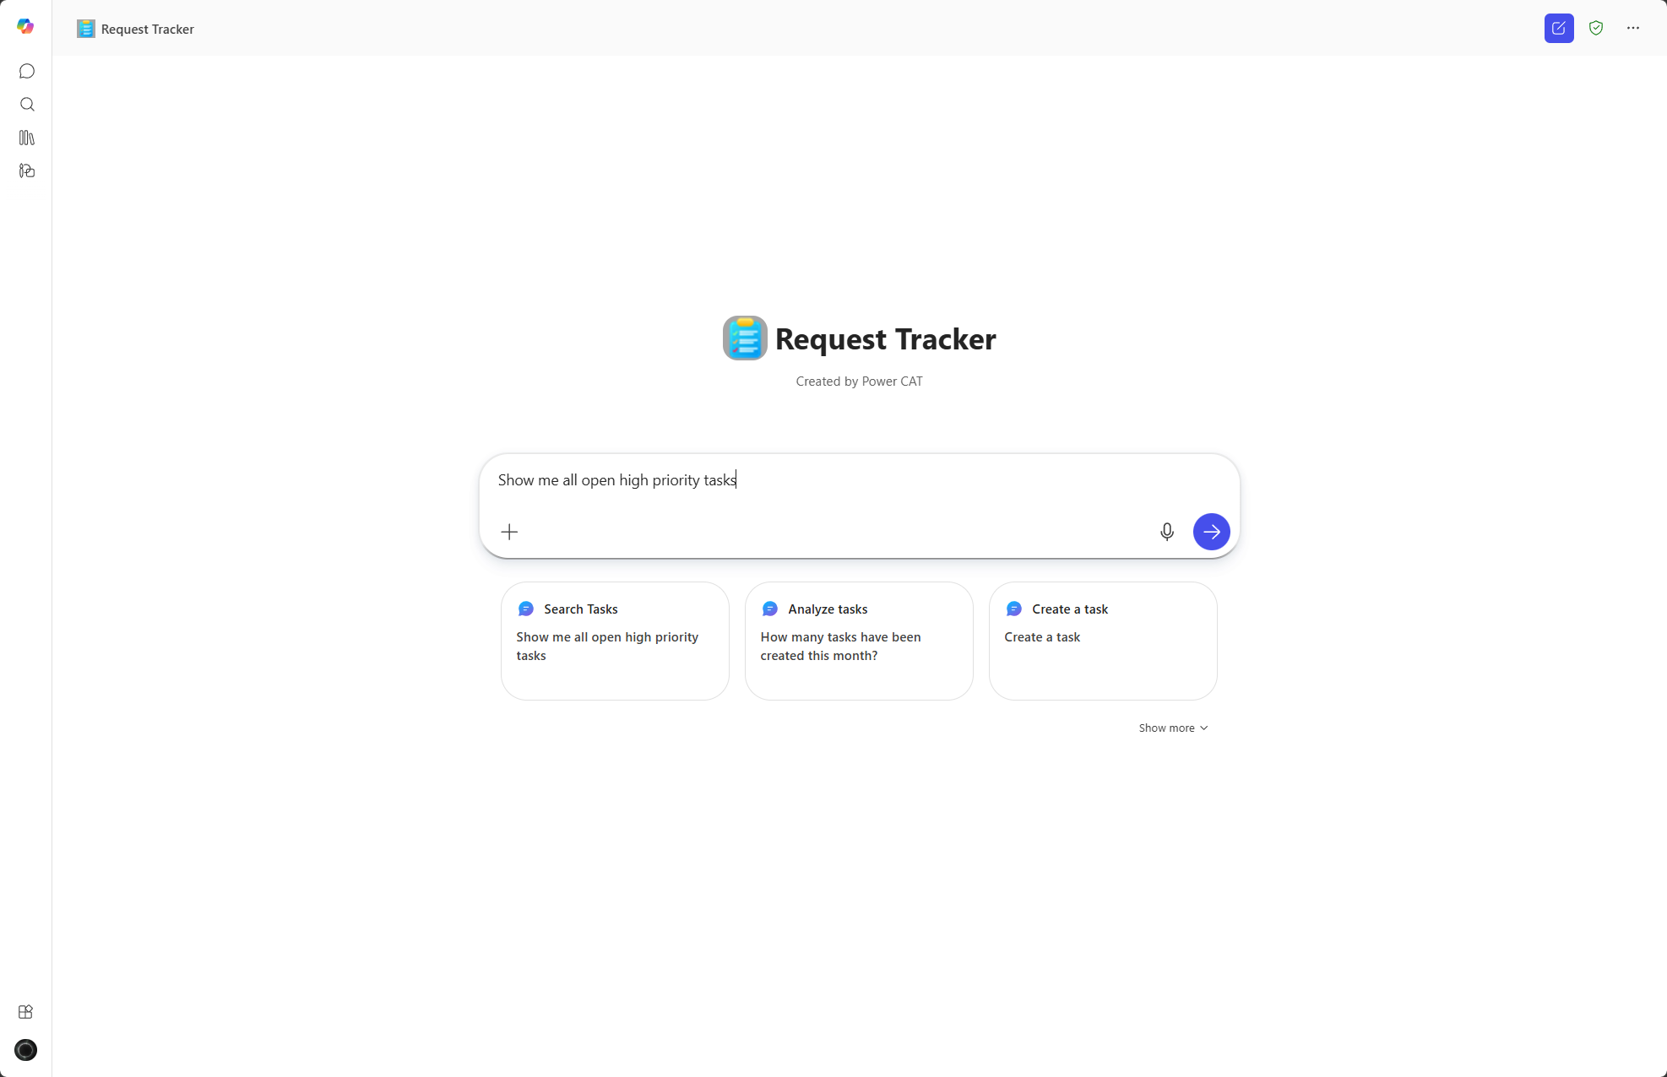
Request Tracker Agent Summary
Agent Overview
Key Challenges
Provide a single, intelligent conversational interface to submit, track, escalate, and resolve internal requests across departments.
Request intake is fragmented across inboxes, spreadsheets, and portals
Duplicate tickets and repeated questions slow resolution
Support teams lack context when requests are escalated
Managers have limited visibility into volume, bottlenecks, and stale requests
📉Fewer duplicate requests
📉 Reduced manual triage effort
📈Faster resolution and improved SLA adherence
📊Clear visibility for team leads and manager
Business Outcomes
Technical Features
💬 Conversational access via Microsoft Teams
📋 Dataverse as system of record
🤖 AI‑driven auto‑categorisation and priority suggestion
⚙️ Power Automate workflows for approvals, notifications, nudges, and digests
© 2026 Microsoft Corporation All rights reserved.
Notes:
CELA disclaimer
Terms displayed or discussed are for explanation/education only. Such terms may differ from your agreement.

Slide 3
Table of Contents
Overview
Persona Example
User Journey Scenario Example
Solution Screenshots
Demo Prompts
Notes:
CELA disclaimer
Terms displayed or discussed are for explanation/education only. Such terms may differ from your agreement.

Slide 4
Request Tracker Agent is a Custom Agent that provides knowledge driven, intelligent request creation with pre‑submission resolution checks, and request lookup through a single conversational interface.
Before creating a new request, the agent searches the full list of requests and identifies similar or existing requests to prevent duplicate submissions.
If no applicable solution is found, the agent guides the user through confirmed request creation—improving intake quality while reducing unnecessary ticket volume.
Overview
© 2026 Microsoft Corporation All rights reserved.

Slide 5


Persona Example
Two core personas example: the employee who needs help and the support team that resolves it.
Employee
Support Team
Requester
Assignee
Needs help with IT, HR, Facilities, Finance, or Security requests
Wants fast answers and visibility without navigating portals
Responsible for triaging and resolving requests
Needs clear context and prioritization
Typical Ask
Typical Ask
"I need a new monitor" or "What's the status of my request?"
"Show me all high-priority requests from this week"
Key Challenges Addressed
Fragmented intake across inboxes, spreadsheets, and portals; duplicate tickets and repeated questions slow resolution; support teams lack context when requests are escalated

Slide 6


User Journey
From natural-language request to automatic resolution tracking, the agent handles the full lifecycle, so employees never chase a ticket again.
1
Trigger
2
Evaluation
3
Output
Employee asks the agent in Teams, e.g., "I need a new monitor" or "What's the status of my request?"
Agent identifies request requirements, asking for additional details, and searches existing requests.
Request is created only if needed
Backbone
SharePoint Issue Tracking List
AI-driven auto-categorisation
Power Automate workflows

Slide 7





High Level Agent Architecture
Request Tracker Agent
Custom agent
Trigger
Agent
1
Knowledge Sources
Request Tracker Agent
2
User
3
Structured response returned to the user
User interacts with the agent via Microsoft Teams or M365 Copilot
Copilot Studio custom agent handles conversation and logic
SharePoint Issue Tracking List stores all request data
Power Automate runs approvals, notifications, nudges, and weekly digests

Slide 8
Agent Solution Screenshots
© 2026 Microsoft Corporation All rights reserved.
Notes:
Title: Click-through demo
Now, let’s see how that all comes together for our key persona.
CELA disclaimer
Terms displayed or discussed are for explanation/education only. Such terms may differ from your agreement.

Slide 9
Request Lookup

Slide 10
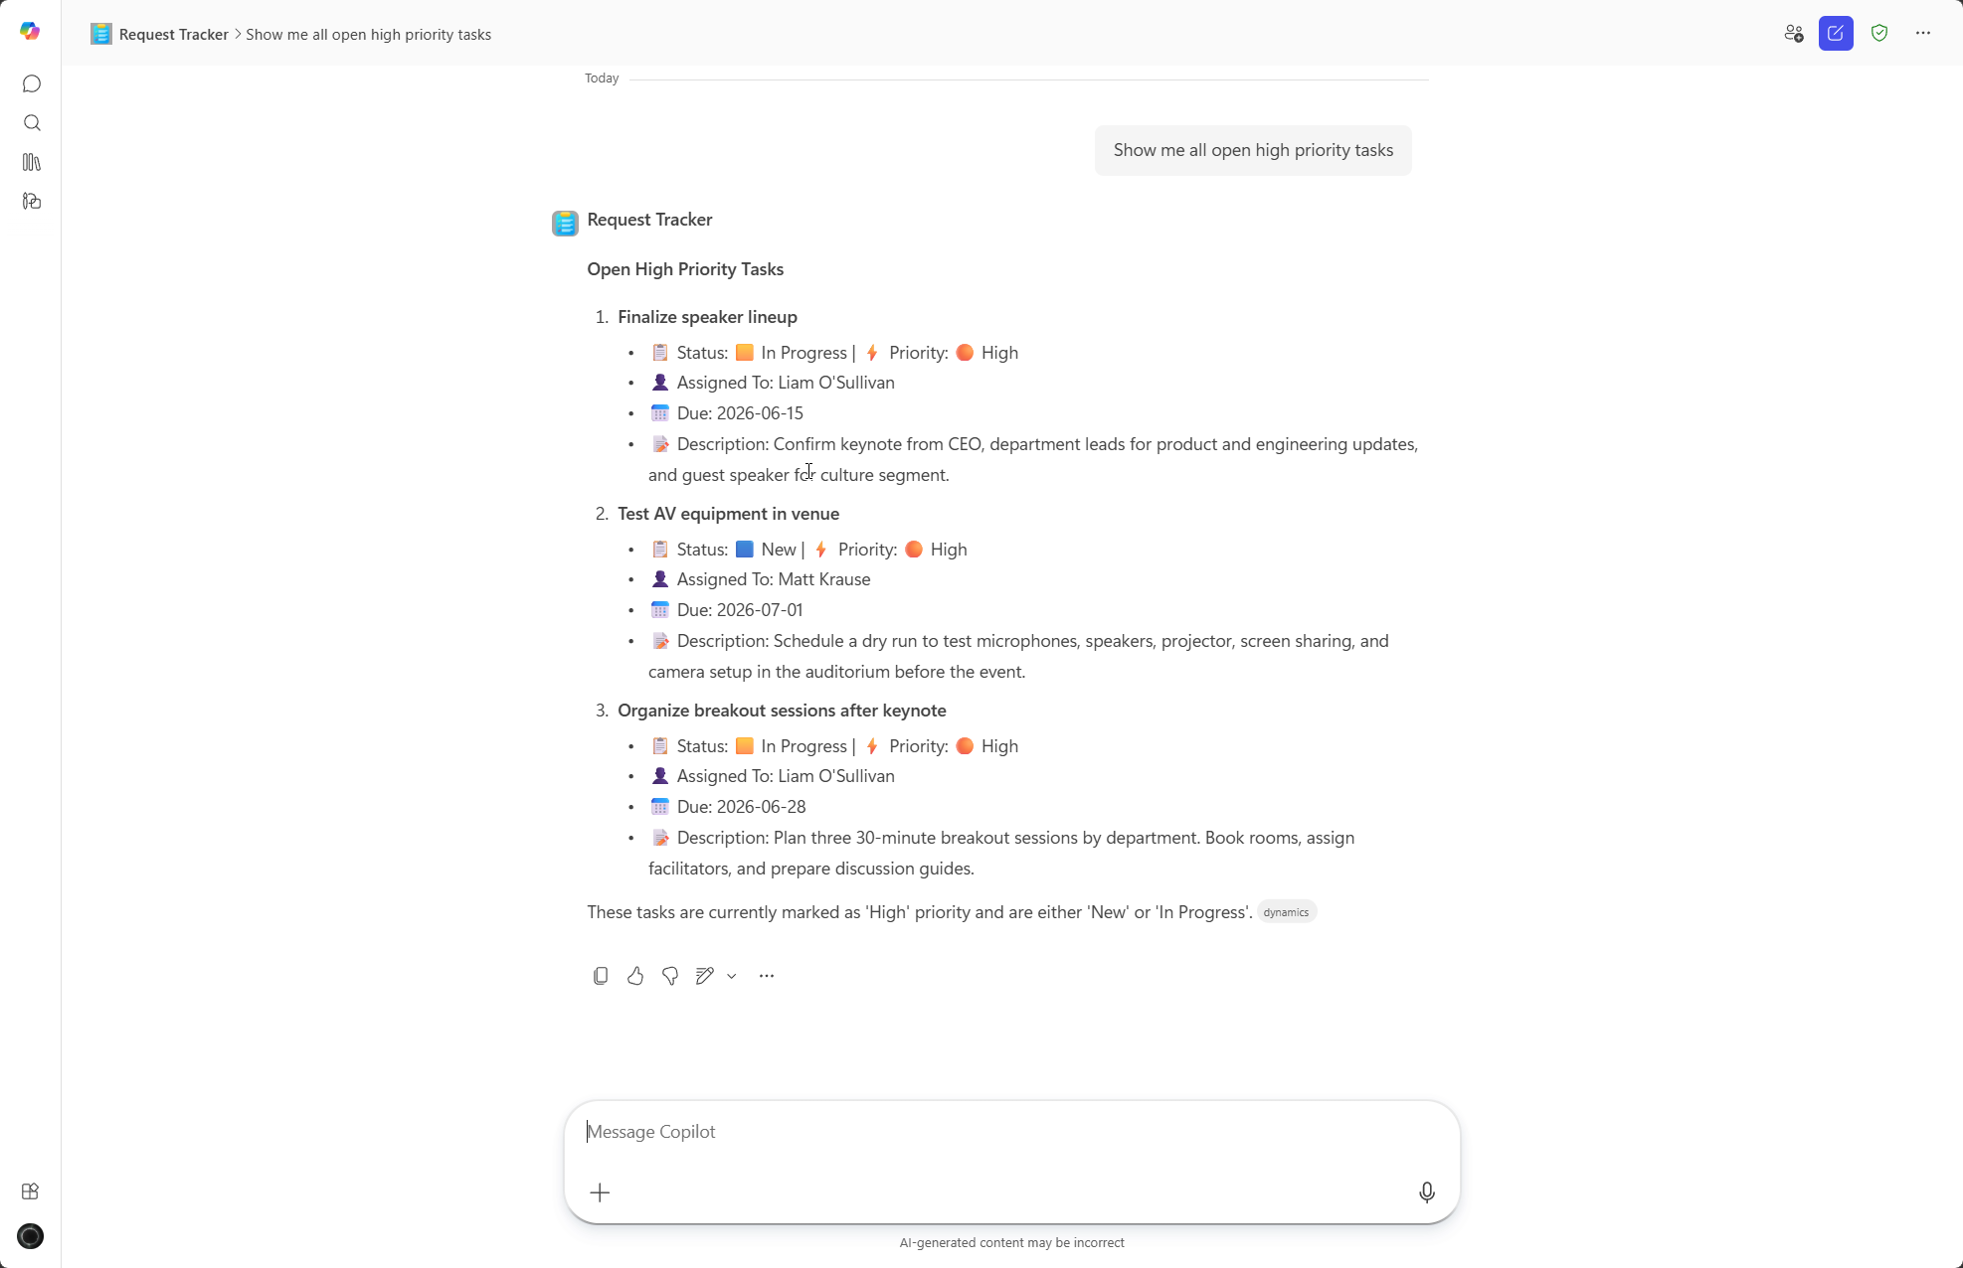
Results
Results

Slide 11
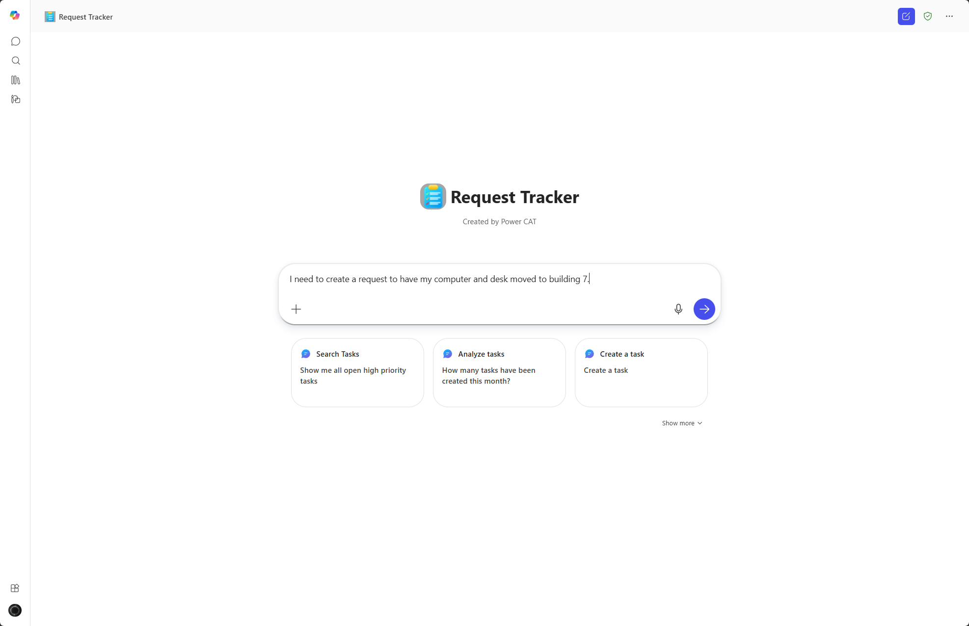
New Request

Slide 12
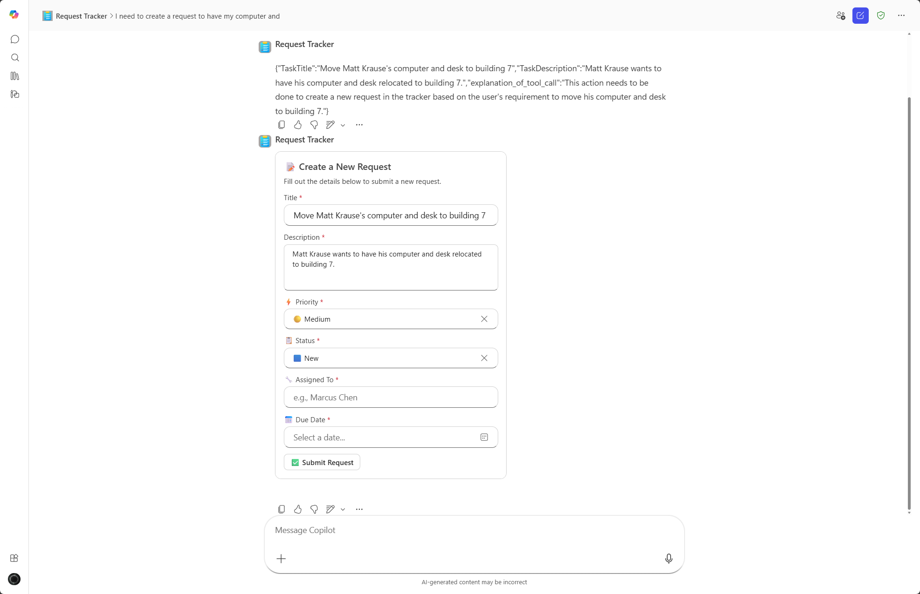
Request Validation

Slide 13
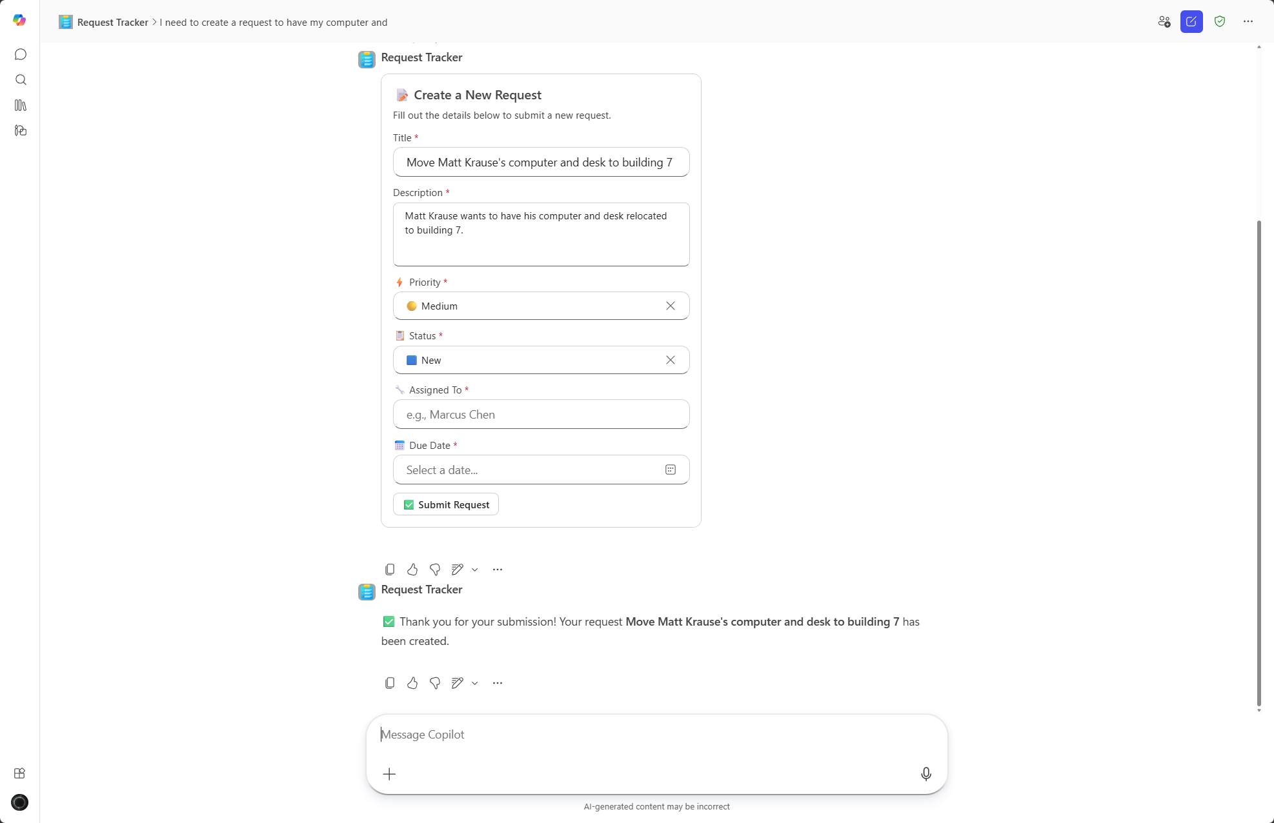
Request Complete

Slide 14
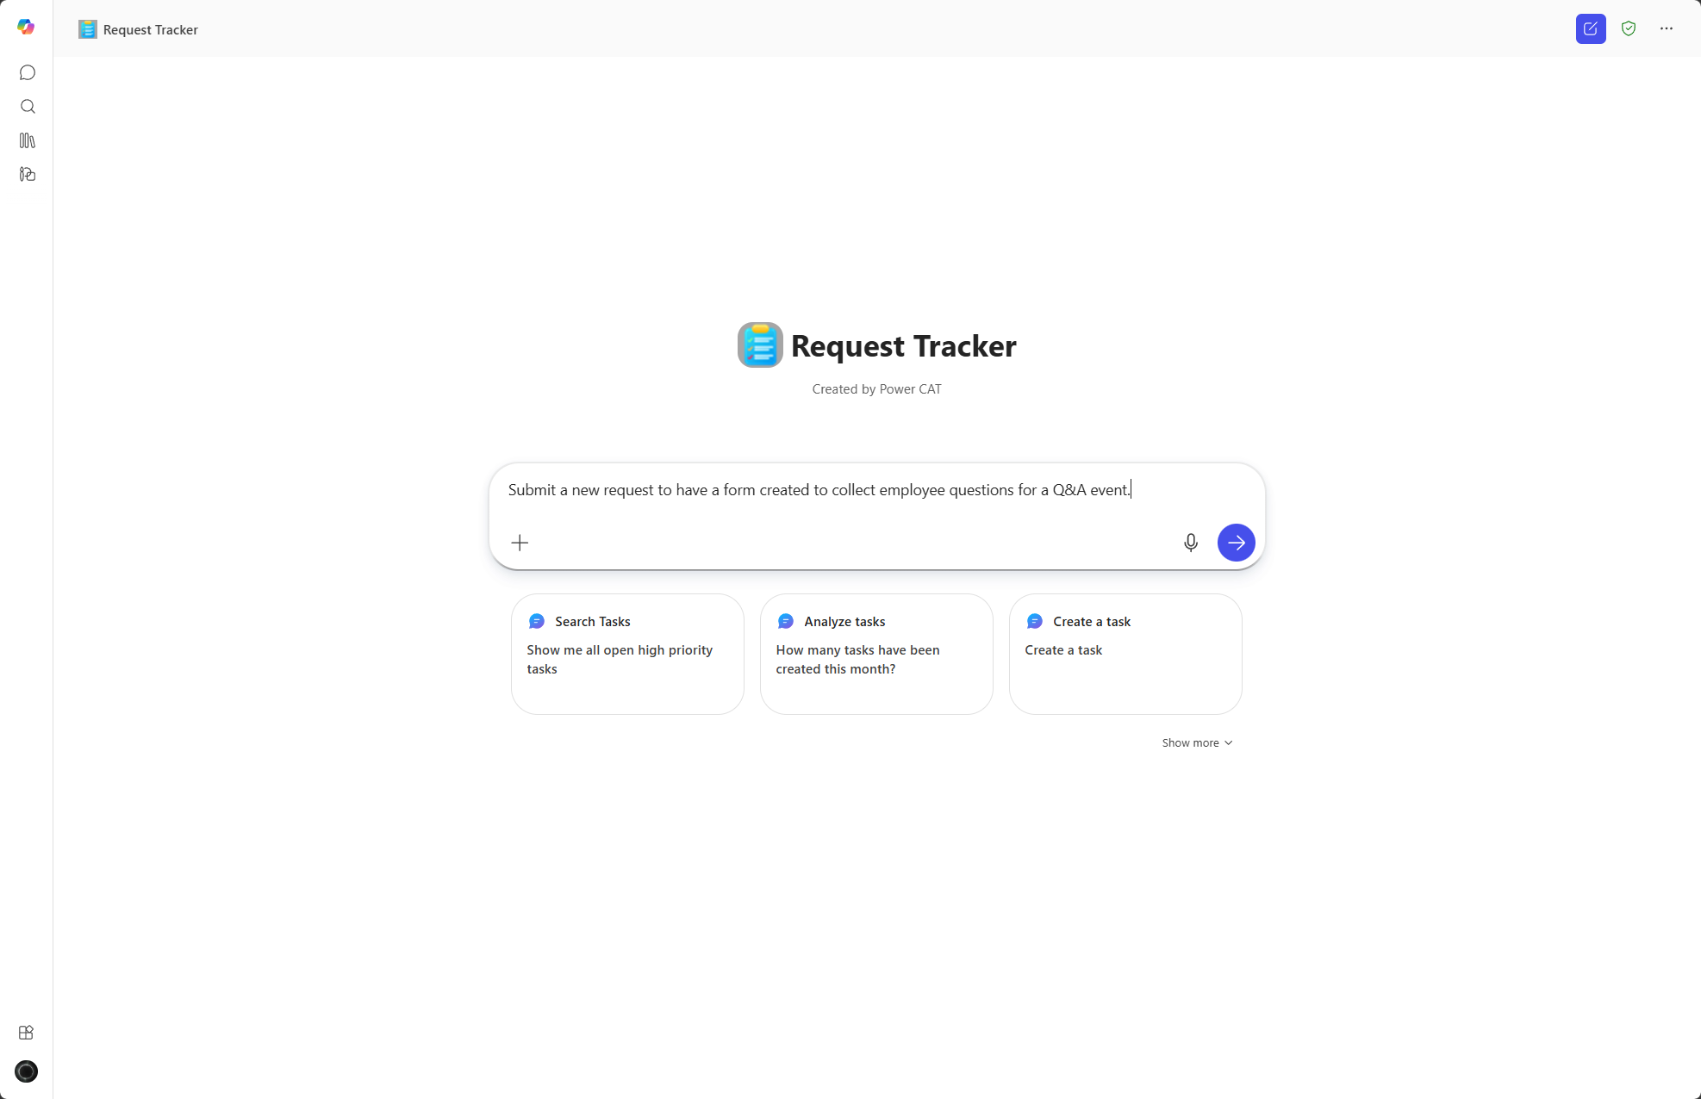
New Request

Slide 15
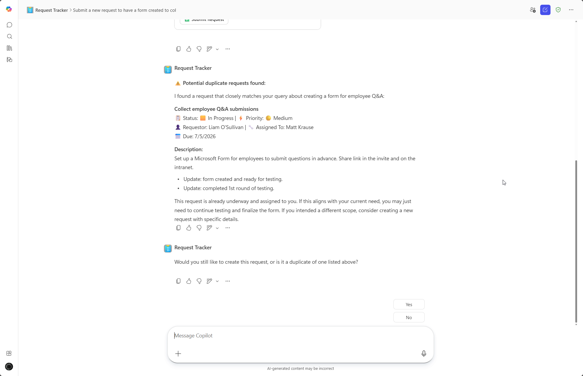
Duplicate Request Detection
Notes:
CELA disclaimer Terms displayed or discussed are for explanation/education only. Such terms may differ from your agreement.

Slide 16

Update Request

Slide 17
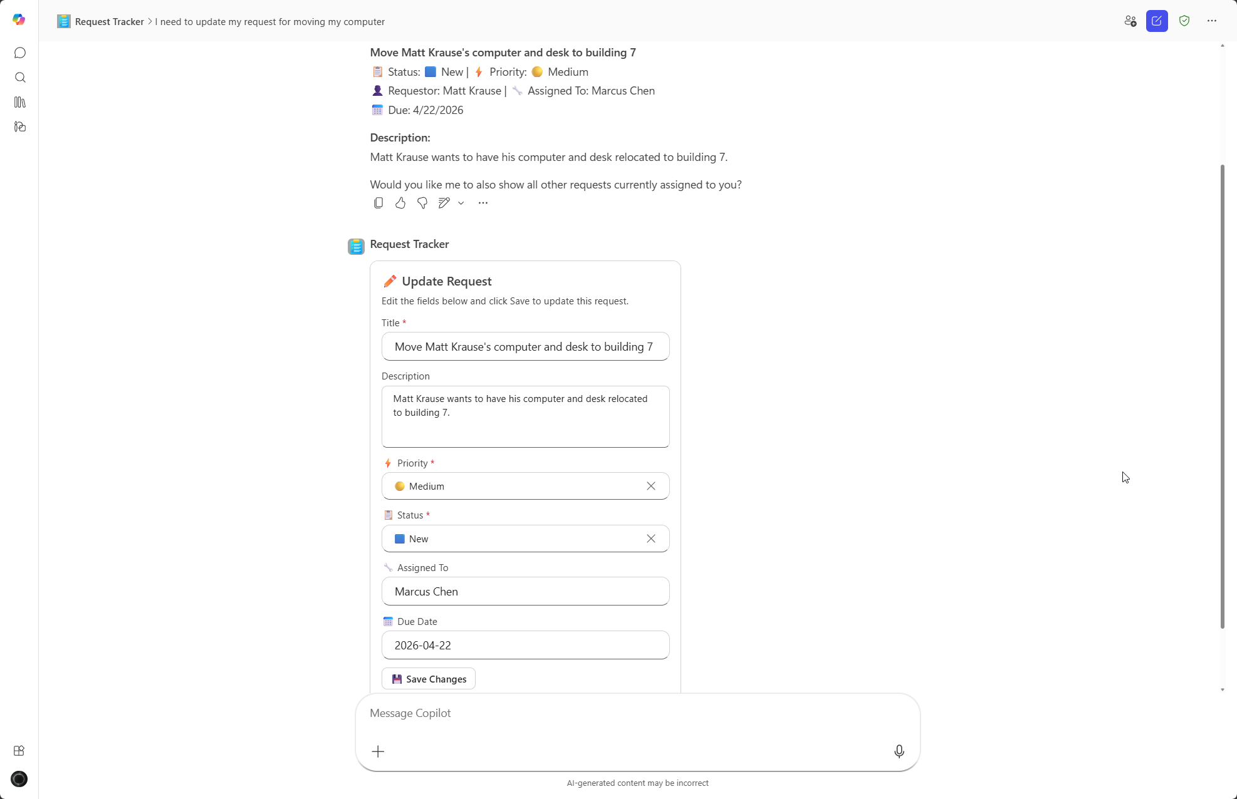
Request Validation

Slide 18
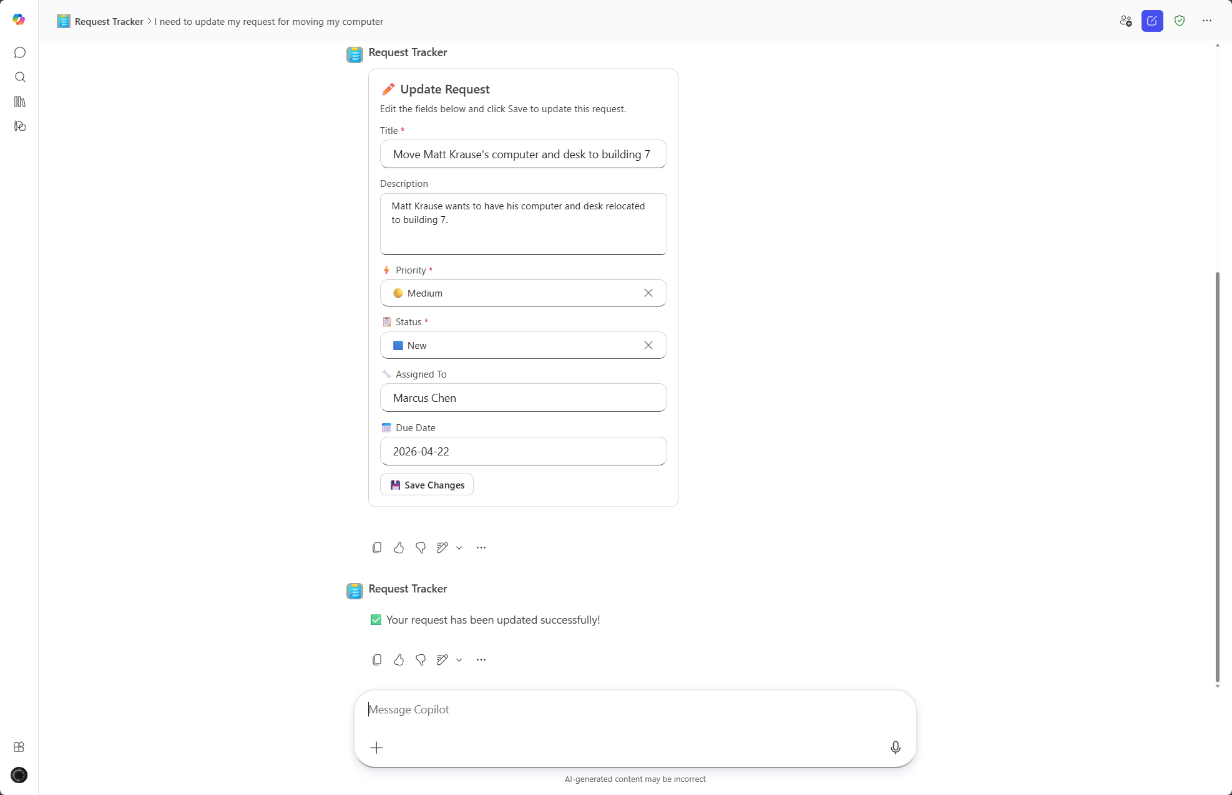
Update Complete

Slide 19
Demo Prompts & Eval Set
Notes:
CELA disclaimer
Terms displayed or discussed are for explanation/education only. Such terms may differ from your agreement.

Slide 20
Demo Prompts & Eval Set
ID | Test Scenario | Prompt | Expected Result
1 | Single Request Status Lookup | "What is the status of the corporate card application request for Raj?" | Returns the current status, assignee, priority, and last activity date for the specified request.
2 | User-Scoped Open Request List | "Show me all of my open requests" | Lists all open requests submitted by the current user with status and priority
3 | Priority + Time-Based Filtering | "Show me all high-priority requests from this week" | Queries the SharePoint list for high-priority requests created in the current week and returns a summary.
4 | Request Escalation Action | "Escalate the request for a legal name change to a higher level team" | Updates the request assignment, attaches conversation history, and notifies the appropriate team.
5 | Count with Priority Filter | "How many low priority requests are open right now?" | Returns a count and summary of all open requests with low priority.
6 | Monthly Aggregate Summary | "Give me a summary of requests from this past month" | Provides an aggregate view of requests: open, closed, escalated, average resolution time.
7 | Stale/Inactive Request Detection | "Are there any stale requests assigned to me?" | Lists requests assigned to the user with no activity in the past X days.
8 | Direct Request Creation | "Help me create a high priority request" | Skips the resolution search and directly creates a categorized, prioritized request.
9 | Approval Status Check | "Was my most recent request approved?" | Checks the approval status of the specified request and returns the current approval state.
10 | Similar Request Search | "Has anyone else reported incorrect overtime pay in their salary check?" | Searches for open and recently resolved requests that matches user's request and returns results.

Slide 21
Demo Prompts & Eval Set (continued)
ID | Test Scenario | Prompt | Expected Result
11 | Keyword-Based Request Search | "What the status of the request on Sarah's new hire onboarding?" | Agent should provide status of request based on keyword search "new hire onboarding" or "Sarah".
12 | Resolved Count with Date Range | "How many requests were resolved this year?" | Agent should filter by Resolved status and a past date range.
13 | Cross-Category Breakdown | "What is the breakdown of requests by category?" | Cross-category summary — agent should return counts grouped by category.
14 | Status-Specific Filter | "Show me all requests that are pending" | Status-specific filter across all categories
15 | Edge Case – Ambiguous Query | "How many requests are there?" | Agent should ask for clarification on status, time, or category.

Slide 22
Thank You
Notes:
CELA disclaimer
Terms displayed or discussed are for explanation/education only. Such terms may differ from your agreement.

